Slide 1
Real Estate Business Analytics
A Data Science Project by:
Lucky D. Camaddu

Slide 2
General Process
Problem Statement
Research Objective
Model View
Findings

Slide 3
Problem Statement
In the real estate industry, accurate property valuation plays a crucial role in making informed buying and selling decisions. Property owners, investors, and real estate professionals rely on accurate and reliable valuation estimates to determine fair market prices, negotiate deals, and assess investment opportunities.

Slide 4
Research Objective
The goal of this project is to develop an intuitive and comprehensive dashboard for descriptive analytics in the real estate industry.
The dashboard will provide users with valuable insights and visualizations based on key factors such as location, property characteristics, market trends, and comparable sales data.
By leveraging advanced data analysis techniques and visualization tools, we aim to create a user-friendly and informative dashboard that enhances the understanding of real estate market dynamics.

Slide 5
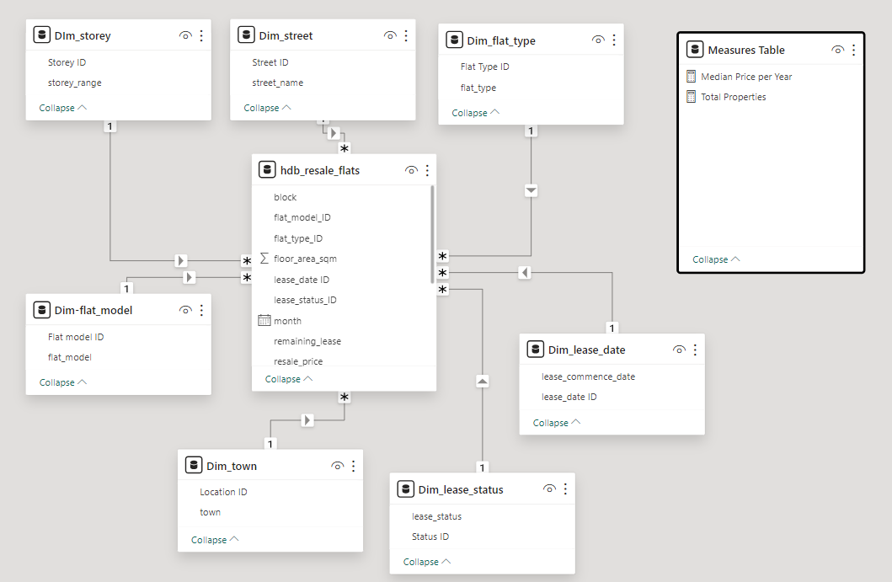
Model View

Slide 6
Dashboard

Slide 7
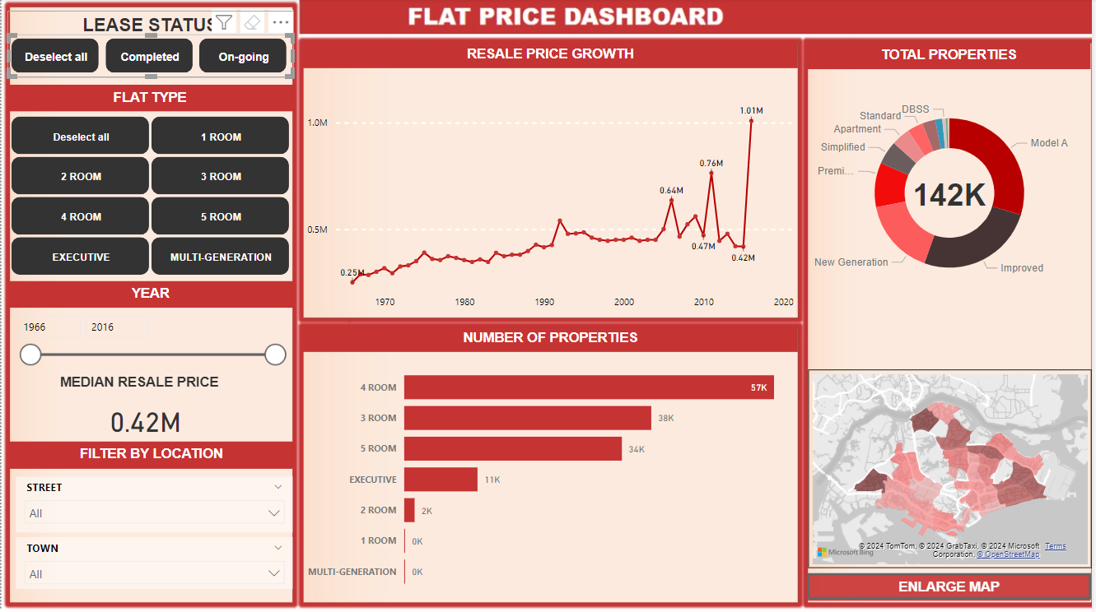

Slide 8
Findings
In general, prices from different flat type are increasing as time goes by.
Woodlands and Jurong West has the highest resale price.
The graph becomes erratic when filtering by flat type due to different flat model.
Recommended to conduct EDA and feature engineering for this dataset.

